Slide 1

APESTRATOS Applying precise engineering to stratos
Philip Zhu, Dimitri Efimoff, Samuel Habtu, Celine Fong, Waseem Hossain, Nikita Yevtukh

Slide 2
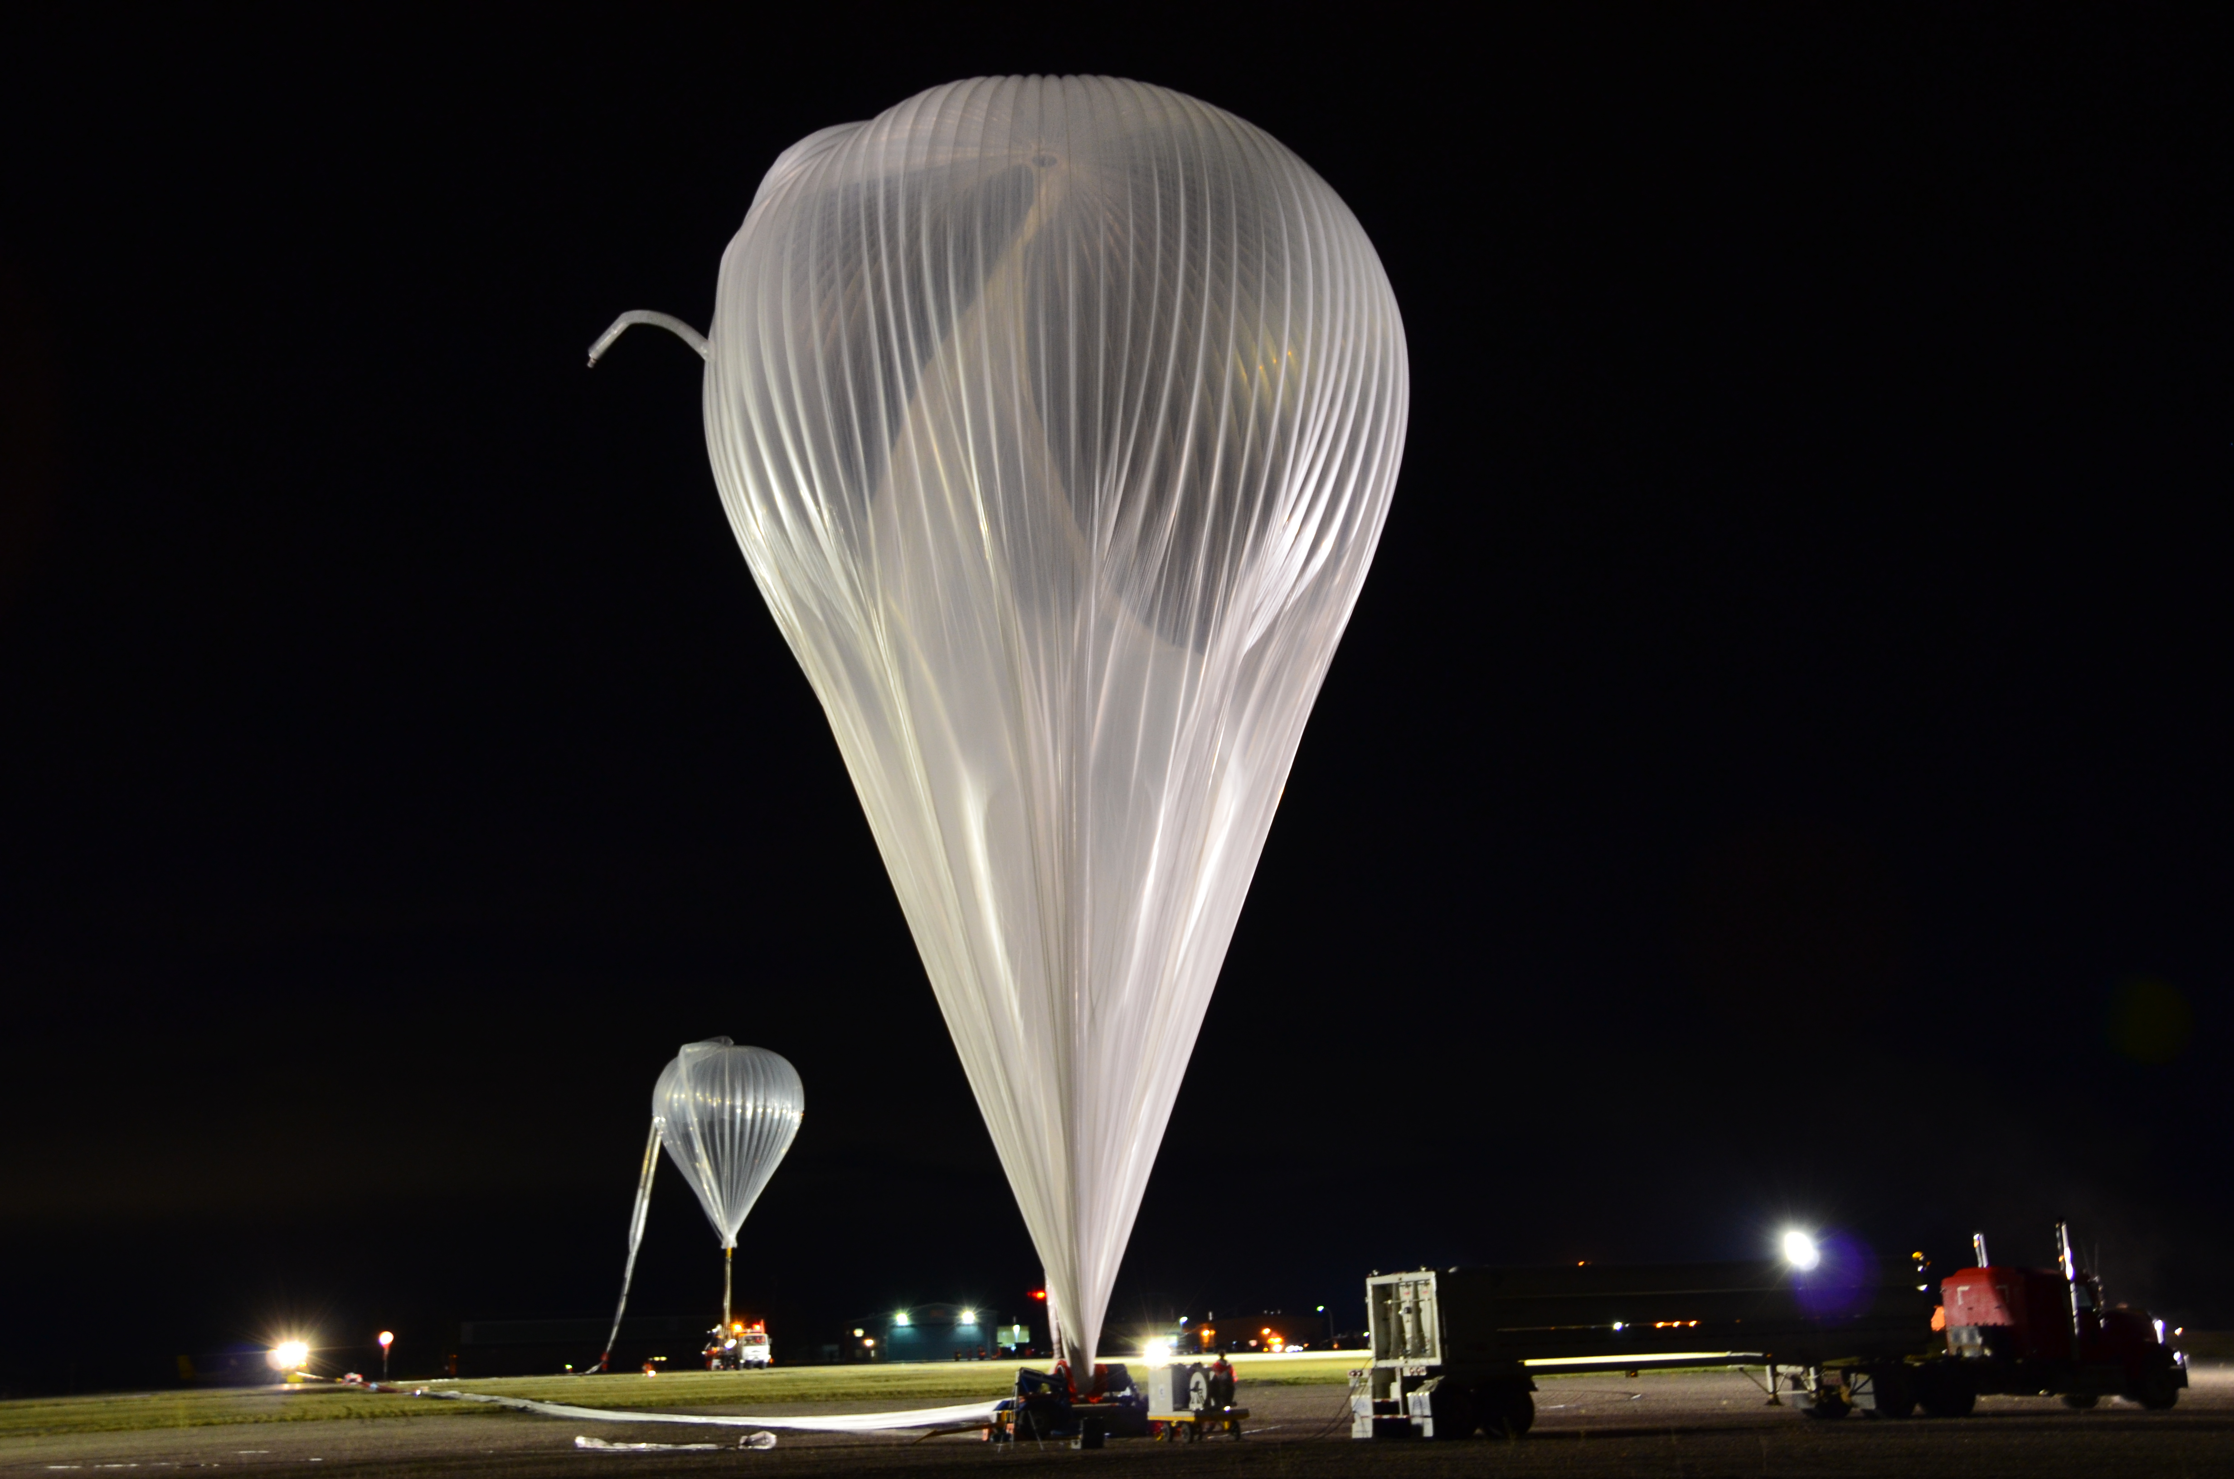
challenge
Create a Web-based Dashboard Tool to help visualize data from the Strato-Science 2018 Campaign
Notes:
EXPLAIN WHAT STRATOS IS

Slide 3
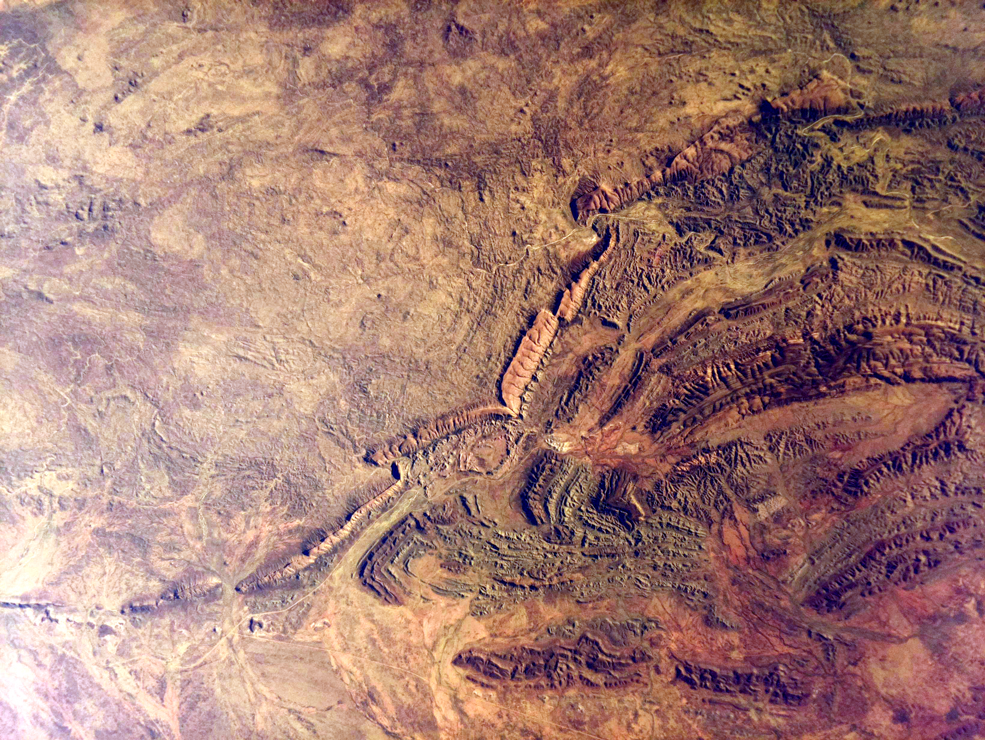
What data was collected?
Data was recorded using a Raspberry Pi
Photos of the horizon and Earth were taken at 2 minute alternating intervals
Telemetry data includes GPS long/lat, altitude, Sun Elevation & Azimuth, etc.
Environment data includes external temperature & pressure, relative humidity, dew point, etc.

Slide 4
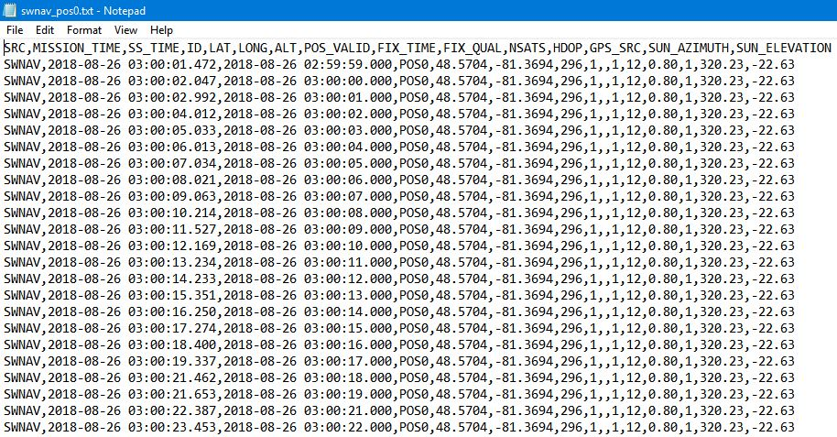
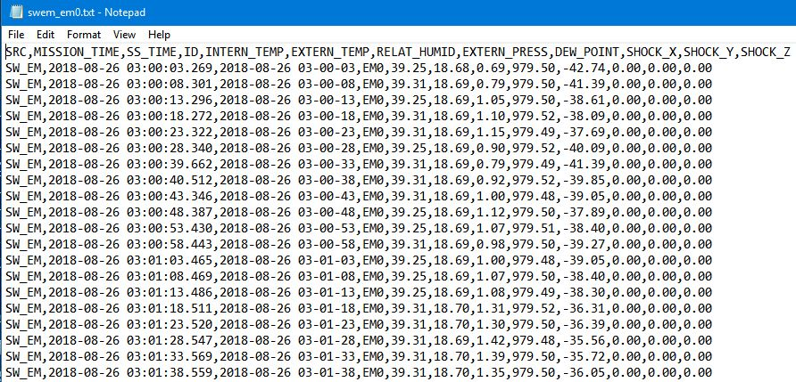
What does the data look like?
7767 data entries
37568 data entries

Slide 5
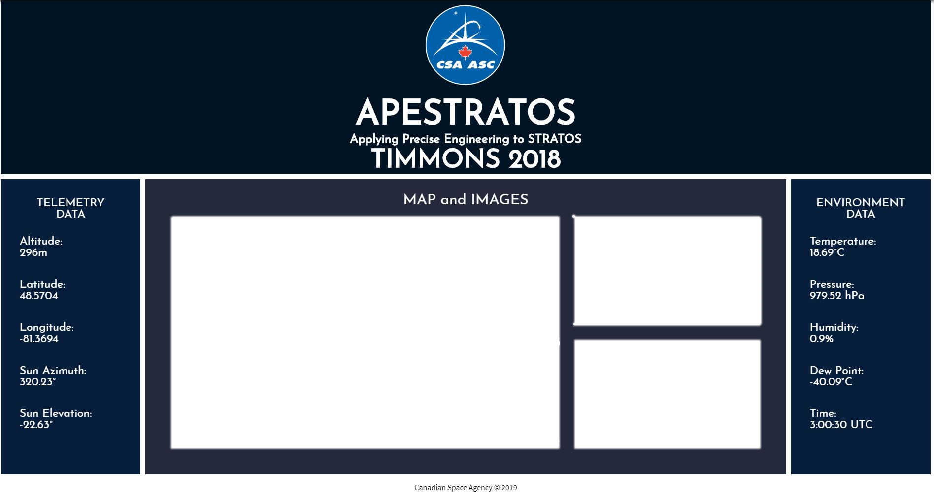
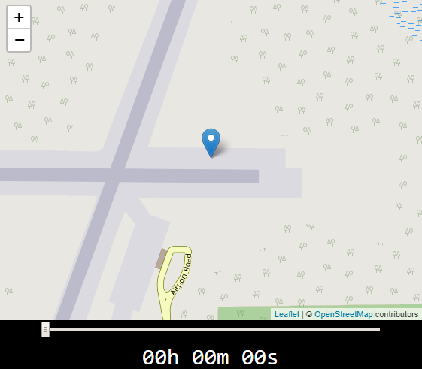
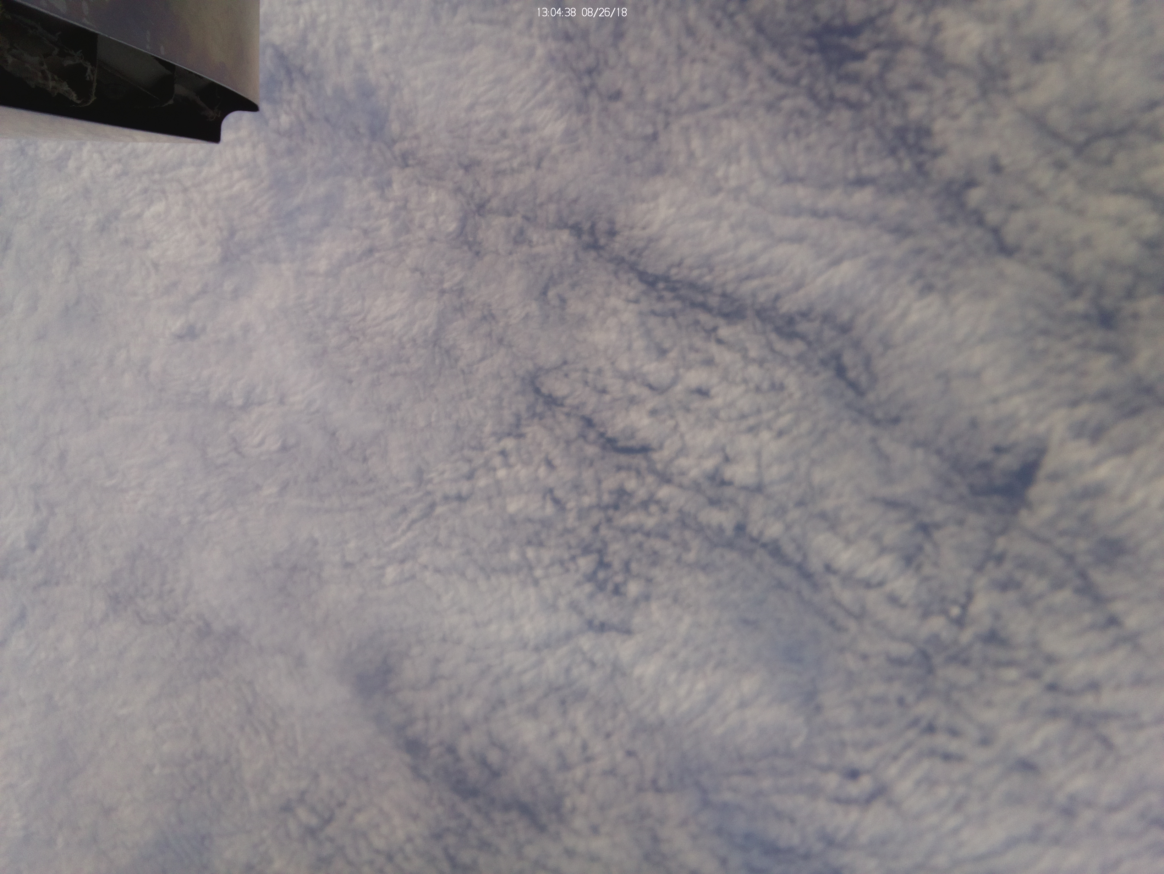
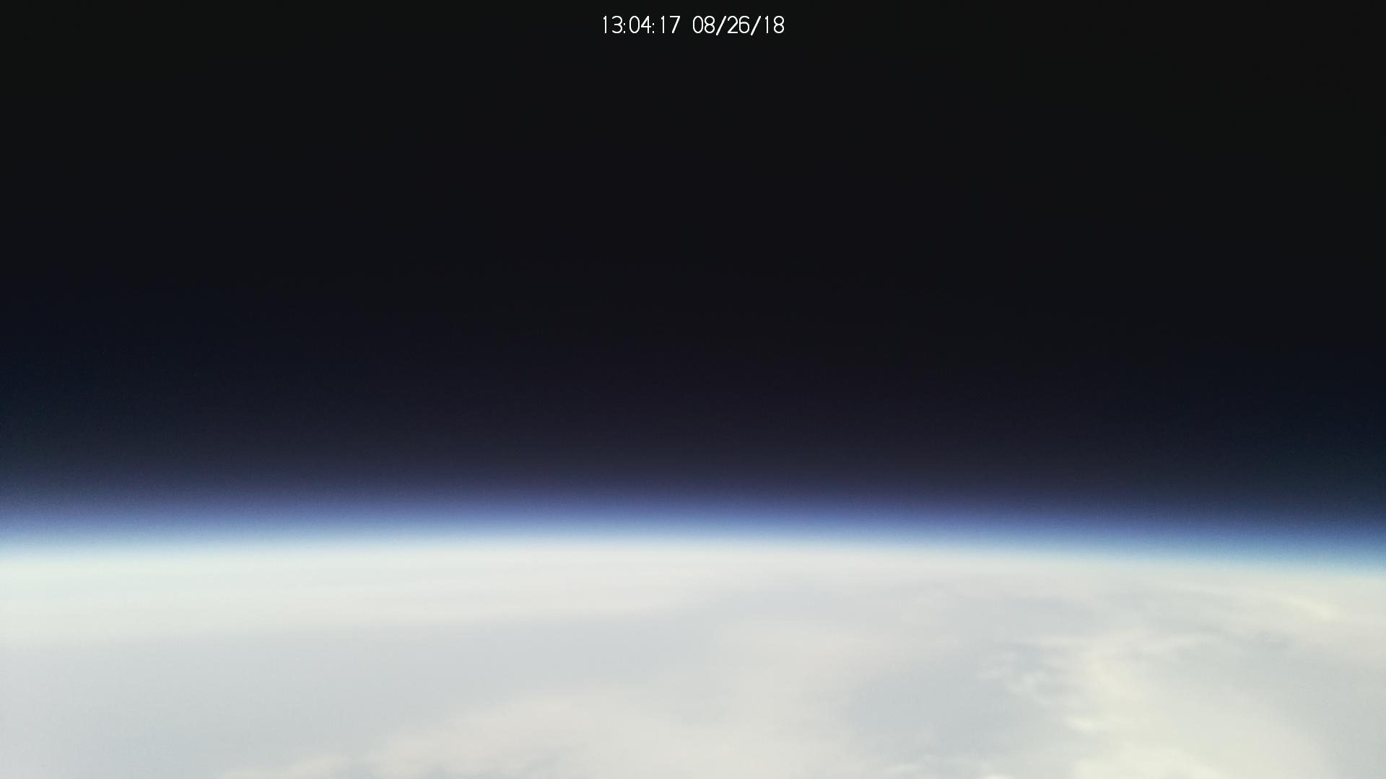

Slide 6
HOW DID WE DO THIS?
We looked at the raw data to figure out its format
Picked what important data to display
Wrote a script that pulled the datapoints from each .txt file to our own matrix, but only those closest to 30s
Created the website to display the information

Slide 7
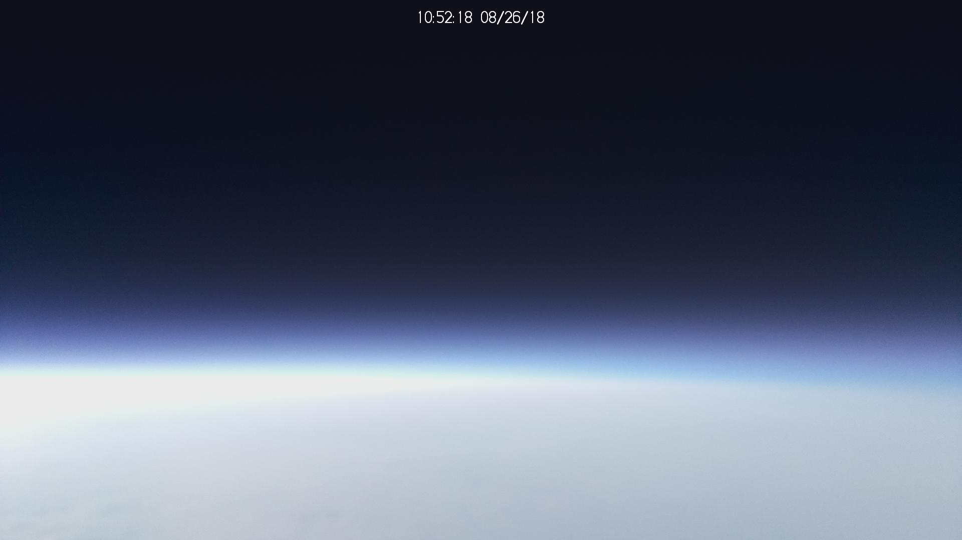
Demonstration
Link

Slide 8
Q&A

